Slide 1
Adapter Classes

Slide 2
In JAVA, an adapter class allows the default implementation of listener interfaces. The notion of listener interfaces stems from the Delegation Event Model. It is one of the many techniques used to handle events in Graphical User Interface (GUI) programming languages, such as JAVA.
Adapter Class: Listener Interface
MouseAdapter: MouseListener

Slide 3
Java adapter classes provide the default implementation of listener interfaces. If we inherit the adapter class, we will not be forced to provide the implementation of all the methods of listener interfaces. So it saves code.

Slide 4
Pros of using Adapter classes:
It assists the unrelated classes to work combined.
It provides ways to use classes in different ways.
It increases the transparency of classes.
It provides a way to include related patterns in the class.
It provides a pluggable kit for developing an application.
It increases the reusability of the class.
The adapter classes are found
java.awt.event,
java.awt.dnd,
and javax.swing.event packages.

Slide 5
java.awt.event Adapter classes
Adapter class | Listener interface
WindowAdapter | WindowListener
KeyAdapter | KeyListener
MouseAdapter | MouseListener
MouseMotionAdapter | MouseMotionListener
FocusAdapter | FocusListener
ComponentAdapter | ComponentListener
ContainerAdapter | ContainerListener
HierarchyBoundsAdapter | HierarchyBoundsListener

Slide 6
java.awt.dnd Adapter classes
Adapter class | Listener interface
DragSourceAdapter | DragSourceListener
DragTargetAdapter | DragTargetListener

Slide 7
javax.swing.event Adapter classes
Adapter class | Listener interface
MouseInputAdapter | MouseInputListener
InternalFrameAdapter | InternalFrameListener

Slide 8
Java WindowAdapter Example
AdapterExample.java
// importing the necessary libraries
import java.awt.*;
import java.awt.event.*;
public class AdapterExample {
// object of Frame
Frame f;
// class constructor
AdapterExample() {
// creating a frame with the title
f = new Frame ("Window Adapter");
// adding the WindowListener to the frame
// overriding the windowClosing() method
f.addWindowListener (new WindowAdapter() {
public void windowClosing (WindowEvent e) {
f.dispose();
}
});
// setting the size, layout and
f.setSize (400, 400);
f.setLayout (null);
f.setVisible (true);
}
// main method
public static void main(String[] args) {
new AdapterExample();
}
}

Slide 9
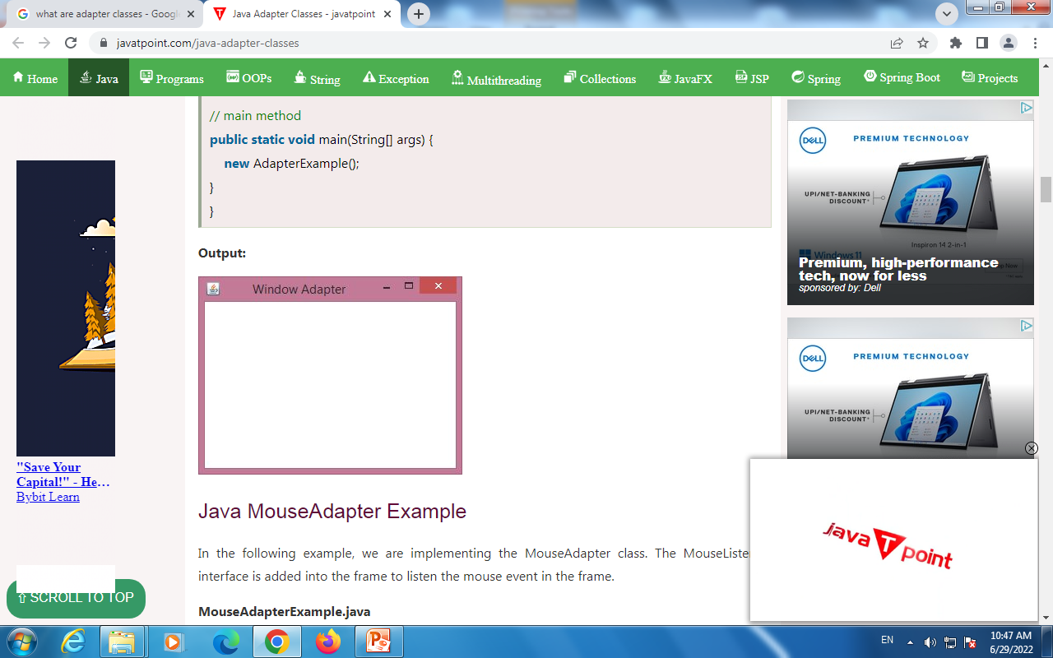

Slide 10
Java MouseAdapter Example
n the following example, we are implementing the MouseAdapter class. The MouseListener interface is added into the frame to listen the mouse event in the frame.
MouseAdapterExample.java

Slide 11
// importing the necessary libraries
import java.awt.*;
import java.awt.event.*;
// class which inherits the MouseAdapter class
public class MouseAdapterExample extends MouseAdapter {
// object of Frame class
Frame f;
// class constructor
MouseAdapterExample() {
// creating the frame with the title
f = new Frame ("Mouse Adapter");
// adding MouseListener to the Frame
f.addMouseListener(this);
// setting the size, layout and visibility of the frame
f.setSize (300, 300);
f.setLayout (null);
f.setVisible (true);
}

Slide 12
// overriding the mouseClicked() method of the MouseAdapter class
public void mouseClicked (MouseEvent e) {
// creating the Graphics object and fetching them from the Frame object using getGraphics() method
Graphics g = f.getGraphics();
// setting the color of graphics object
g.setColor (Color.BLUE);
// setting the shape of graphics object
g.fillOval (e.getX(), e.getY(), 30, 30);
}
// main method
public static void main(String[] args) {
new MouseAdapterExample();
}
}

Slide 13
